Slide 1
Topic 5
Rectangular Optical Waveguides
Coláiste na hOllscoile Corcaigh, Éire University College Cork, Ireland
ROINN NA FISICE
Department of Physics
Slide 5.<number>

Slide 2
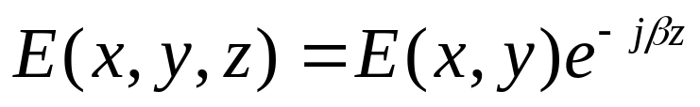
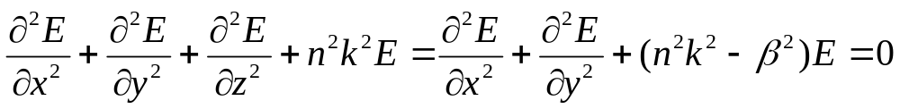
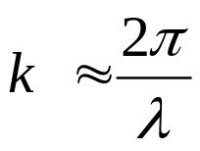


Waveguides
Again consider a nearly plane wave:
The wave equation can be written as:
Coláiste na hOllscoile Corcaigh, Éire University College Cork, Ireland
ROINN NA FISICE
Department of Physics
Slide 5.<number>

Slide 3



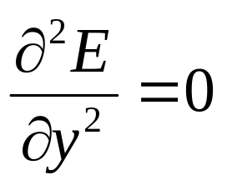
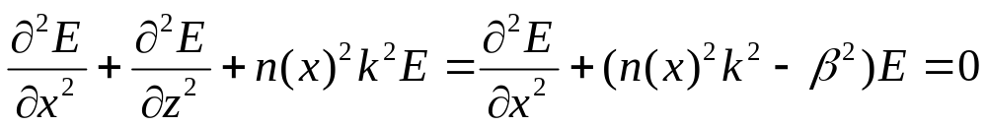
Slab Waveguides
Now look at a slab waveguide:
A
x
z
B
C
Coláiste na hOllscoile Corcaigh, Éire University College Cork, Ireland
ROINN NA FISICE
Department of Physics
Slide 5.<number>

Slide 4
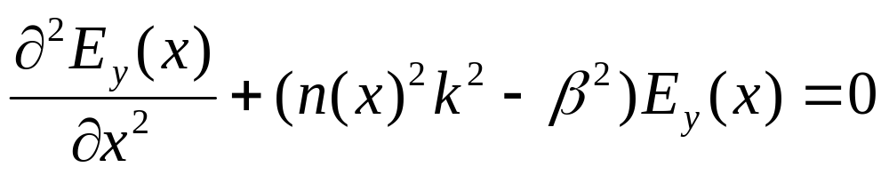
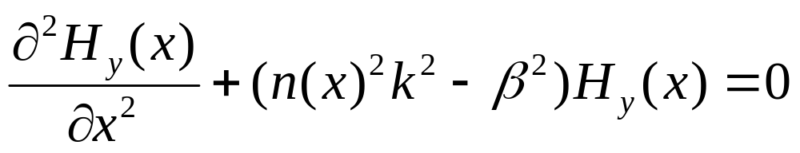
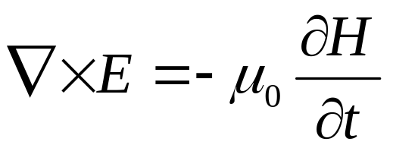
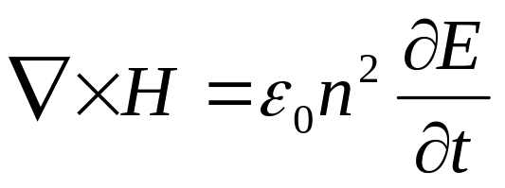
Slab Waveguides
Two possible equations (polarizations):
TE
TM
Where:
Coláiste na hOllscoile Corcaigh, Éire University College Cork, Ireland
ROINN NA FISICE
Department of Physics
Slide 5.<number>

Slide 5

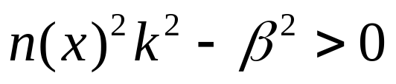
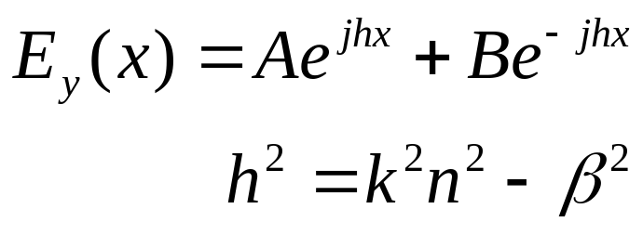
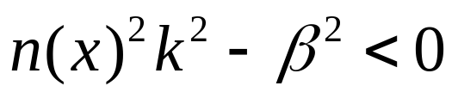
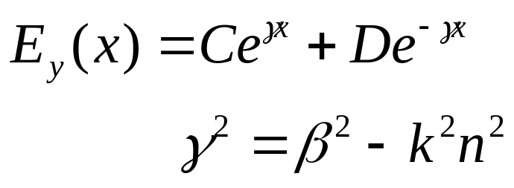
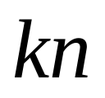


Slab Waveguides
TE
Coláiste na hOllscoile Corcaigh, Éire University College Cork, Ireland
ROINN NA FISICE
Department of Physics
Slide 5.<number>

Slide 6
Slab Waveguides
Boundary Conditions:
A
x
x=a
z
B
x=-a
C
Easiest Solution:
  Invoke symmetry (n₁=n₃), +/- a
  Solutions symmetric or anti-symmetric at x=0
  Apply boundary conditions:
    E_{y} and H_{z} continuous at boundary
Coláiste na hOllscoile Corcaigh, Éire University College Cork, Ireland
ROINN NA FISICE
Department of Physics
Slide 5.<number>

Slide 7
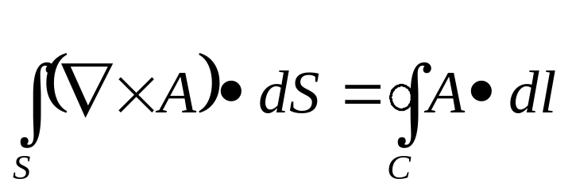
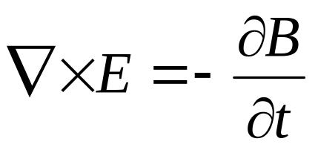
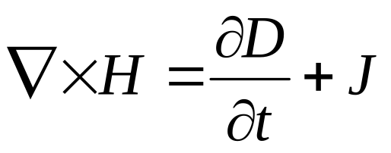
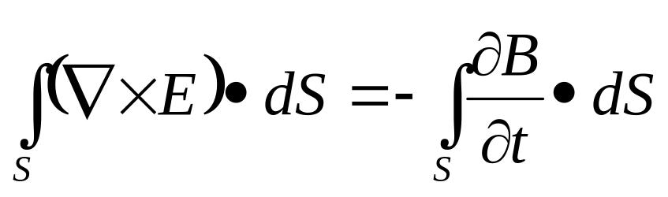
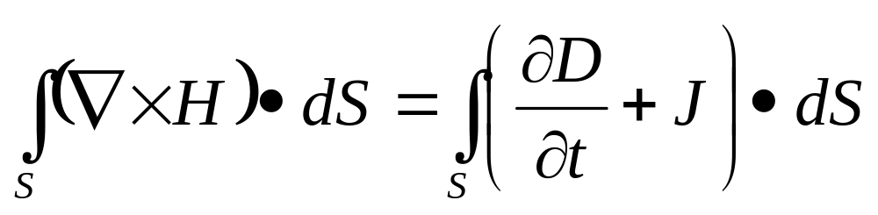
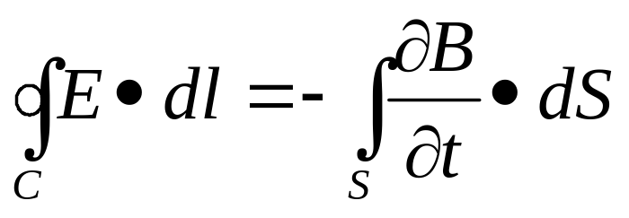
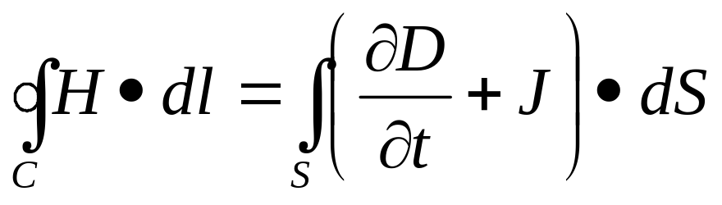
Boundary Condition
Start with Stokes Theorem:
Apply to Maxwell:
Coláiste na hOllscoile Corcaigh, Éire University College Cork, Ireland
ROINN NA FISICE
Department of Physics
Slide 5.<number>

Slide 8

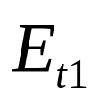

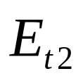


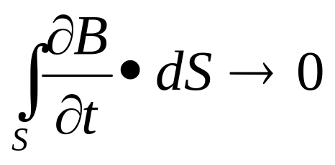
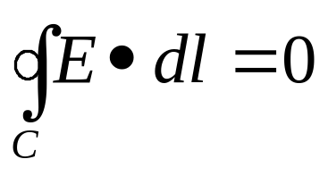

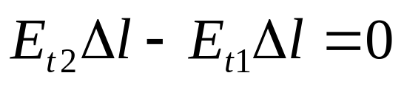
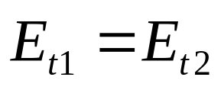
EM at the Boundary
As:
Thus:
The transverse portion is continuous across the boundary
Coláiste na hOllscoile Corcaigh, Éire University College Cork, Ireland
ROINN NA FISICE
Department of Physics
Slide 5.<number>

Slide 9
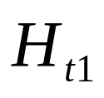

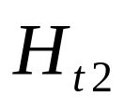
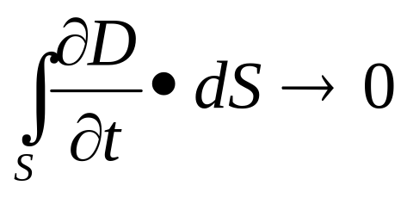
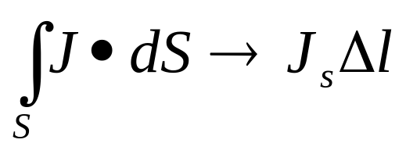
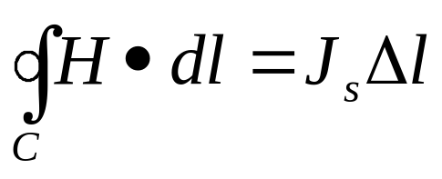
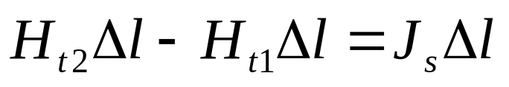
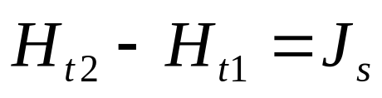
EM at the Boundary
As:
But if there is a surface current:
Thus:
Coláiste na hOllscoile Corcaigh, Éire University College Cork, Ireland
ROINN NA FISICE
Department of Physics
Slide 5.<number>

Slide 10
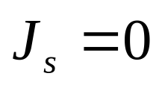
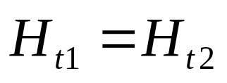

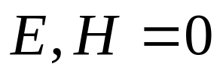
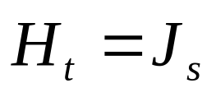
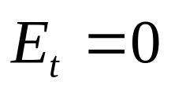
EM at the Boundary
If both sides of the boundary are lossless dielectrics
Then:
…continuous across boundary
For a perfect conductor:
inside the conductor
Thus:
Coláiste na hOllscoile Corcaigh, Éire University College Cork, Ireland
ROINN NA FISICE
Department of Physics
Slide 5.<number>

Slide 11
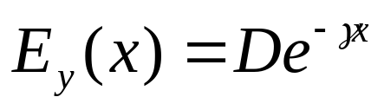
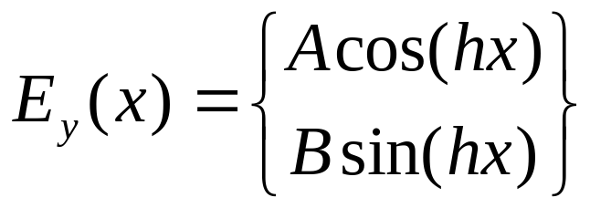
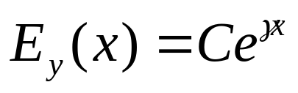
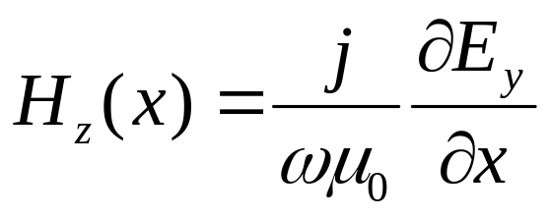
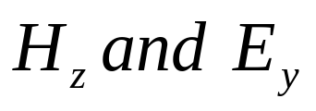
Slab Waveguides
A
B
C
Note:
are both continuous
Coláiste na hOllscoile Corcaigh, Éire University College Cork, Ireland
ROINN NA FISICE
Department of Physics
Slide 5.<number>

Slide 12
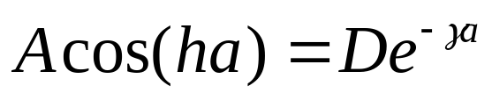
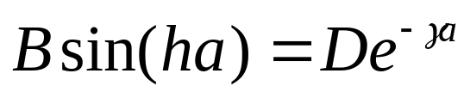
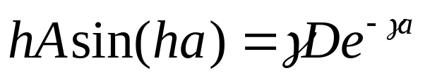
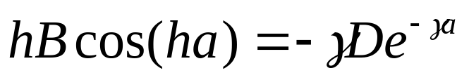
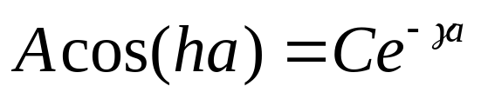
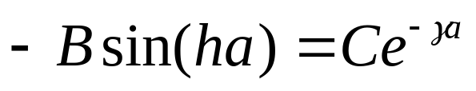






Slab Waveguides
symmetric
antisymmetric
x=a
x=-a
Coláiste na hOllscoile Corcaigh, Éire University College Cork, Ireland
ROINN NA FISICE
Department of Physics
Slide 5.<number>

Slide 13






Slab Waveguides
Need to calculate: h and γ
symmetric
antisymmetric
Coláiste na hOllscoile Corcaigh, Éire University College Cork, Ireland
ROINN NA FISICE
Department of Physics
Slide 5.<number>

Slide 14




Slab Waveguides
For graphical solution:
symmetric
antisymmetric
Consider:
  2a = 4 μm
  = 1.55 μm
  n₂ = 3.1
  n₁ = 3.0
Coláiste na hOllscoile Corcaigh, Éire University College Cork, Ireland
ROINN NA FISICE
Department of Physics
Slide 5.<number>

Slide 15

Slab Waveguide Solution
TE0
TE1
TE2
TE3
TE4
Coláiste na hOllscoile Corcaigh, Éire University College Cork, Ireland
ROINN NA FISICE
Department of Physics
Slide 5.<number>

Slide 16



Slab Waveguides
TM
With the equivalent solutions:
A
B
C
Coláiste na hOllscoile Corcaigh, Éire University College Cork, Ireland
ROINN NA FISICE
Department of Physics
Slide 5.<number>

Slide 17



Slab Waveguides
The difference is in the boundary conditions:
are both continuous
Constant across boundary
NOT Constant across boundary
Coláiste na hOllscoile Corcaigh, Éire University College Cork, Ireland
ROINN NA FISICE
Department of Physics
Slide 5.<number>

Slide 18






Slab Waveguides
symmetric
antisymmetric
x=a
x=-a
Coláiste na hOllscoile Corcaigh, Éire University College Cork, Ireland
ROINN NA FISICE
Department of Physics
Slide 5.<number>

Slide 19


Slab Waveguides
For graphical solution:
symmetric
antisymmetric
Consider:
  2a = 0.4 μm
  = 1.55 μm
  n₂ = 3.1
  n₁ = 3.0
Coláiste na hOllscoile Corcaigh, Éire University College Cork, Ireland
ROINN NA FISICE
Department of Physics
Slide 5.<number>

Slide 20


Slab Waveguide Solution
TE0
2a = 0.4 μm
TM0
Coláiste na hOllscoile Corcaigh, Éire University College Cork, Ireland
ROINN NA FISICE
Department of Physics
Slide 5.<number>

Slide 21


Slab Waveguide Solution
TE0
2a = 0.175 μm
TM0
Coláiste na hOllscoile Corcaigh, Éire University College Cork, Ireland
ROINN NA FISICE
Department of Physics
Slide 5.<number>

Slide 22

TE & TM Modes
h is longer for the TM mode than for the TE
Coláiste na hOllscoile Corcaigh, Éire University College Cork, Ireland
ROINN NA FISICE
Department of Physics
Slide 5.<number>

Slide 23


Modes
TE0: 2a=0.4μm
TE0: 2a=4μm
Coláiste na hOllscoile Corcaigh, Éire University College Cork, Ireland
ROINN NA FISICE
Department of Physics
Slide 5.<number>

Slide 24
Slab Graphical Solution
TE0
TE1
TE2
TE3
TE4
Coláiste na hOllscoile Corcaigh, Éire University College Cork, Ireland
ROINN NA FISICE
Department of Physics
Slide 5.<number>

Slide 25


Slab Numerical Method
Equations:
symmetric
antisymmetric
Coláiste na hOllscoile Corcaigh, Éire University College Cork, Ireland
ROINN NA FISICE
Department of Physics
Slide 5.<number>

Slide 26



Effective Index
Coláiste na hOllscoile Corcaigh, Éire University College Cork, Ireland
ROINN NA FISICE
Department of Physics
Slide 5.<number>

Slide 27







Numerical Aperture
x=a
x=-a
Coláiste na hOllscoile Corcaigh, Éire University College Cork, Ireland
ROINN NA FISICE
Department of Physics
Slide 5.<number>

Slide 28





More on Waveguides
V Parameter
2a = waveguide thickness
Coláiste na hOllscoile Corcaigh, Éire University College Cork, Ireland
ROINN NA FISICE
Department of Physics
Slide 5.<number>

Slide 29
Slab Waveguide Solution
TE0
TE1
TE2
TE3
TE4
Coláiste na hOllscoile Corcaigh, Éire University College Cork, Ireland
ROINN NA FISICE
Department of Physics
Slide 5.<number>

Slide 30




Number of Modes
There are modes every
For single mode want:
So:
Coláiste na hOllscoile Corcaigh, Éire University College Cork, Ireland
ROINN NA FISICE
Department of Physics
Slide 5.<number>

Slide 31
Slab Waveguide Solution
TE0
TE1
TE2
TE3
TE4
Coláiste na hOllscoile Corcaigh, Éire University College Cork, Ireland
ROINN NA FISICE
Department of Physics
Slide 5.<number>

Slide 32

Confinement Factor
A
B
C
Coláiste na hOllscoile Corcaigh, Éire University College Cork, Ireland
ROINN NA FISICE
Department of Physics
Slide 5.<number>

Slide 33



Confinement Factor
Coláiste na hOllscoile Corcaigh, Éire University College Cork, Ireland
ROINN NA FISICE
Department of Physics
Slide 5.<number>

Slide 34



Confinement Factor
Coláiste na hOllscoile Corcaigh, Éire University College Cork, Ireland
ROINN NA FISICE
Department of Physics
Slide 5.<number>

Slide 35


Confinement Factor
Coláiste na hOllscoile Corcaigh, Éire University College Cork, Ireland
ROINN NA FISICE
Department of Physics
Slide 5.<number>

Slide 36





Confinement Factor
Coláiste na hOllscoile Corcaigh, Éire University College Cork, Ireland
ROINN NA FISICE
Department of Physics
Slide 5.<number>

Slide 37



Confinement Factor
Since the waveguide thickness:
And:
Coláiste na hOllscoile Corcaigh, Éire University College Cork, Ireland
ROINN NA FISICE
Department of Physics
Slide 5.<number>

Slide 38



Poynting Vector
But there is no variation in the y-direction:
Look at the TE mode:
We have already partly evaluated this integral in calculating the confinement factor
Coláiste na hOllscoile Corcaigh, Éire University College Cork, Ireland
ROINN NA FISICE
Department of Physics
Slide 5.<number>

Slide 39



More on Waveguides
First Remember:
Useful Trigonometric Identities:
Coláiste na hOllscoile Corcaigh, Éire University College Cork, Ireland
ROINN NA FISICE
Department of Physics
Slide 5.<number>

Slide 40



Poynting Vector
Coláiste na hOllscoile Corcaigh, Éire University College Cork, Ireland
ROINN NA FISICE
Department of Physics
Slide 5.<number>

Slide 41




d_{eff}
Consider a cosine function:
The power in the field is:
What does this mean?
The field effectively exists within a width of
Coláiste na hOllscoile Corcaigh, Éire University College Cork, Ireland
ROINN NA FISICE
Department of Physics
Slide 5.<number>

Slide 42




Total Internal Reflection
Coláiste na hOllscoile Corcaigh, Éire University College Cork, Ireland
ROINN NA FISICE
Department of Physics
Slide 5.<number>

Slide 43




Total Internal Reflection
Note, with:
It is possible that
So:
Coláiste na hOllscoile Corcaigh, Éire University College Cork, Ireland
ROINN NA FISICE
Department of Physics
Slide 5.<number>

Slide 44








Goos-Hänchen
Reminder: total internal reflection
Coláiste na hOllscoile Corcaigh, Éire University College Cork, Ireland
ROINN NA FISICE
Department of Physics
Slide 5.<number>

Slide 45







Goos-Hänchen
Reality Check using:
Coláiste na hOllscoile Corcaigh, Éire University College Cork, Ireland
ROINN NA FISICE
Department of Physics
Slide 5.<number>

Slide 46





Goos-Hänchen
We can then calculate the phase change at the reflection.
What distance is implied by a phase change?
Coláiste na hOllscoile Corcaigh, Éire University College Cork, Ireland
ROINN NA FISICE
Department of Physics
Slide 5.<number>

Slide 47






Goos-Hänchen
Coláiste na hOllscoile Corcaigh, Éire University College Cork, Ireland
ROINN NA FISICE
Department of Physics
Slide 5.<number>

Slide 48






Goos-Hänchen
1/γ
Coláiste na hOllscoile Corcaigh, Éire University College Cork, Ireland
ROINN NA FISICE
Department of Physics
Slide 5.<number>

Slide 49








Asymmetric Guide Solution
TE Solution
For a guided mode, there should be exponentials in the regions described by:
Coláiste na hOllscoile Corcaigh, Éire University College Cork, Ireland
ROINN NA FISICE
Department of Physics
Slide 5.<number>

Slide 50



Asymmetric Waveguides
For a cosine behaviour:
For an exponential behaviour:
In the asymmetric guide, there are two γ’s:
These are called: p and q .
Coláiste na hOllscoile Corcaigh, Éire University College Cork, Ireland
ROINN NA FISICE
Department of Physics
Slide 5.<number>

Slide 51


Asymmetric Waveguides
Boundary Conditions:
x
A
x=t
B
x=0
C
We cannot invoke symmetry.
But we still apply the same boundary conditions as before.
Coláiste na hOllscoile Corcaigh, Éire University College Cork, Ireland
ROINN NA FISICE
Department of Physics
Slide 5.<number>

Slide 52



Asymmetric Waveguides
A
B
C
Note:
are both continuous
Coláiste na hOllscoile Corcaigh, Éire University College Cork, Ireland
ROINN NA FISICE
Department of Physics
Slide 5.<number>

Slide 53







Asymmetric Waveguides
x=t
x=0
Therefore, we can simplify the initial equations:
Coláiste na hOllscoile Corcaigh, Éire University College Cork, Ireland
ROINN NA FISICE
Department of Physics
Slide 5.<number>

Slide 54




Asymmetric Waveguides
Dividing these yields:
Coláiste na hOllscoile Corcaigh, Éire University College Cork, Ireland
ROINN NA FISICE
Department of Physics
Slide 5.<number>

Slide 55

Asymmetric Waveguides
Which can then be further simplified to:
4 unknowns (p,q,h,β ):
and 4 equations…
Coláiste na hOllscoile Corcaigh, Éire University College Cork, Ireland
ROINN NA FISICE
Department of Physics
Slide 5.<number>

Slide 56
2D Optical Waveguides
Marcatili’s Method
C
n₃
0
E
A
D
n₄
n₂
n₄
-T
B
n₁
-W/2
W/2
Coláiste na hOllscoile Corcaigh, Éire University College Cork, Ireland
ROINN NA FISICE
Department of Physics
Slide 5.<number>

Slide 57


Marcatili’s Method
Solution based on variable separation:
A
B
C
D
E
Coláiste na hOllscoile Corcaigh, Éire University College Cork, Ireland
ROINN NA FISICE
Department of Physics
Slide 5.<number>

Slide 58






Continuity across boundaries
At y=0,-T
Coláiste na hOllscoile Corcaigh, Éire University College Cork, Ireland
ROINN NA FISICE
Department of Physics
Slide 5.<number>

Slide 59






Continuity across boundaries
At x=-W/2,W/2
Coláiste na hOllscoile Corcaigh, Éire University College Cork, Ireland
ROINN NA FISICE
Department of Physics
Slide 5.<number>

Slide 60







Marcatili’s Method
Inserting into wave equation also provides:
One equation per γ
Coláiste na hOllscoile Corcaigh, Éire University College Cork, Ireland
ROINN NA FISICE
Department of Physics
Slide 5.<number>

Slide 61




Effective Index method
Let:
Coláiste na hOllscoile Corcaigh, Éire University College Cork, Ireland
ROINN NA FISICE
Department of Physics
Slide 5.<number>

Slide 62



Effective Index method
For a typical waveguide device, n(x,y) changes
must faster in y than x
First Solve:
This gives:
Coláiste na hOllscoile Corcaigh, Éire University College Cork, Ireland
ROINN NA FISICE
Department of Physics
Slide 5.<number>

Slide 63


3D Optical Waveguides
Insert into original equation to give:
Therefore:
The solution to this equation provides the answer.
Coláiste na hOllscoile Corcaigh, Éire University College Cork, Ireland
ROINN NA FISICE
Department of Physics
Slide 5.<number>

Slide 64









Effective Index Method 1
Ridge Waveguide
Calculate:
Coláiste na hOllscoile Corcaigh, Éire University College Cork, Ireland
ROINN NA FISICE
Department of Physics
Slide 5.<number>

Slide 65


Effective Index Method 2
Ridge Waveguide
Calculate:
Coláiste na hOllscoile Corcaigh, Éire University College Cork, Ireland
ROINN NA FISICE
Department of Physics
Slide 5.<number>

